Slide 2
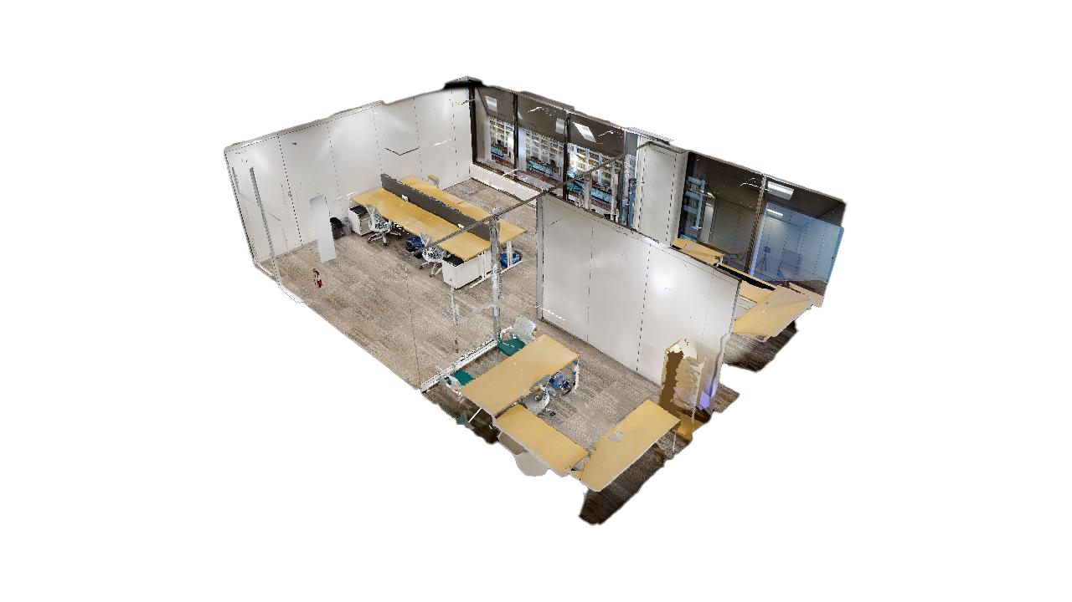
About Suite 440
2 offices and open workstations | 978 SF
Grow your business in the center of it all. The common space is equipped with TV, waiting area, and kitchenette with new appliances. It’s filled with plush soft-seating and locally made, original art pieces. Wi-Fi ensures smooth sailing.
Bright natural light amplifies the space which comes fully furnished with sit-stand working desks and premium task chairs.

Slide 3
Suite 440
Sit-stand desks
Fully-wired and furnished
Large windows overlooking downtown Calgary
Small reception area
978 SF
Bow Valley Square
Contact us today!
Available:
September 1, 2024

Slide 4
4th Floor
Multi-use shared meeting rooms
Original local artworks
Fully-wired and furnished
Large windows overlooking Toronto
Suite 440 | 978 SF
Bow Valley Square
Suite 430
Suite 420
Suite 415
Suite 410
Suite 440
Suite 490
Suite 450
Suite 460
Suite 470
Suite 480
Contact us today!
Available:
September 1, 2024
Office
Shared Meeting Room
Kitchenette & Lounge
Elevators

Slide 5
Connect
Sara Tokhanbeigi
Manager, Office Leasing
Mobile: 604.893.3295
Email: stokhanbeigi@oxfordproperties.com

