Slide 2
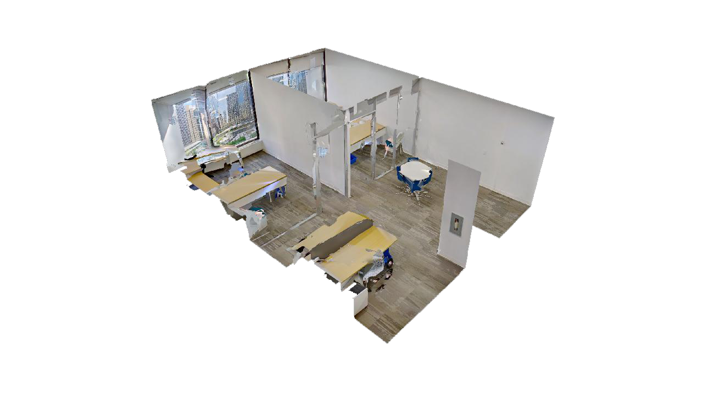
About Suite 585
2 offices open area | 701 SF
Grow your business in the center of it all. The common space is equipped with TV, waiting area, and kitchenette with new appliances. It’s filled with plush soft-seating and locally made, original art pieces. Wi-Fi ensures smooth sailing.
Bright natural light amplifies the space which comes fully furnished with 4 sit-stand working desks and premium task chairs.

Slide 3
Suite 585
4 sit-stand desks
Fully-wired and furnished
Large windows overlooking downtown Calgary
Small reception area
701 SF
Bow Valley Square
Call us today!

Slide 4
5th Floor
Multi-use shared meeting rooms
Original locally painted artworks
Fully-wired and furnished
Large windows overlooking Calgary
Suite 585 | 701 SF
Bow Valley Square
Suite 515
Suite 535
Suite 530
Suite 525
Suite 520
Suite 545
Suite 505
Suite 555
Call us today!
Suite 565
Suite 575
Suite 585
Suite 595
Office
Shared Meeting Room
Kitchenette & Lounge
Elevators

Slide 5
Connect
Sara Tokhanbeigi
Manager, Office Leasing
Mobile: 604.893.3295
Email: stokhanbeigi@oxfordproperties.com

