Slide 2
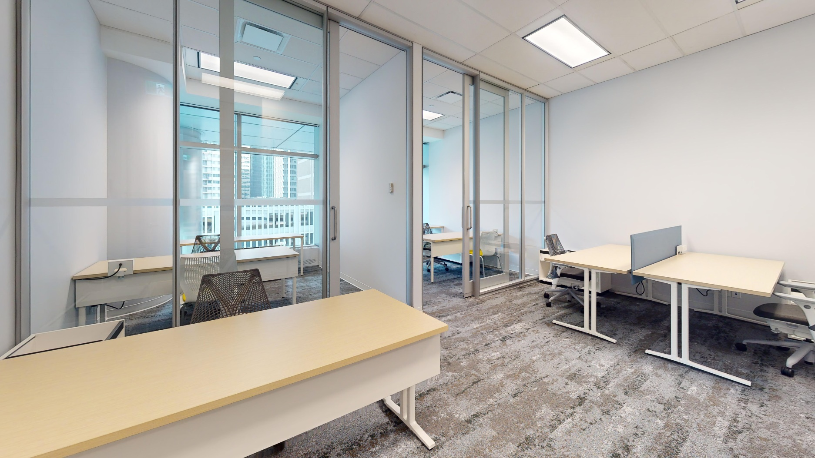
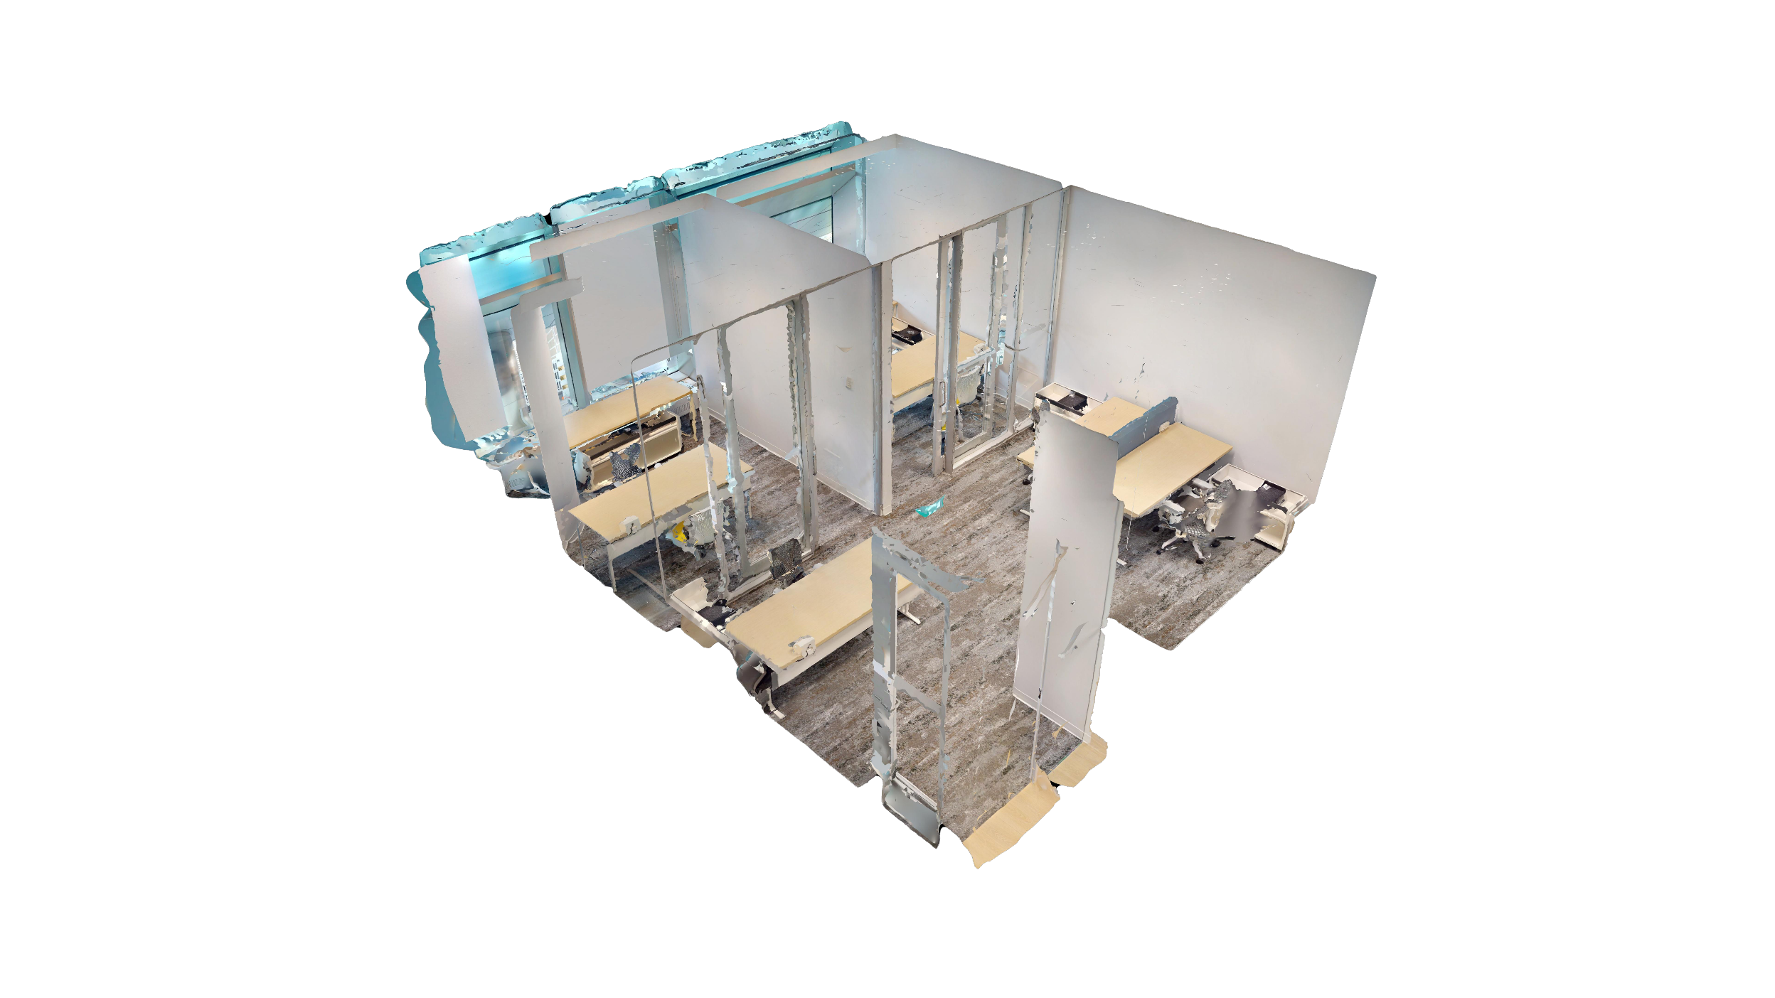
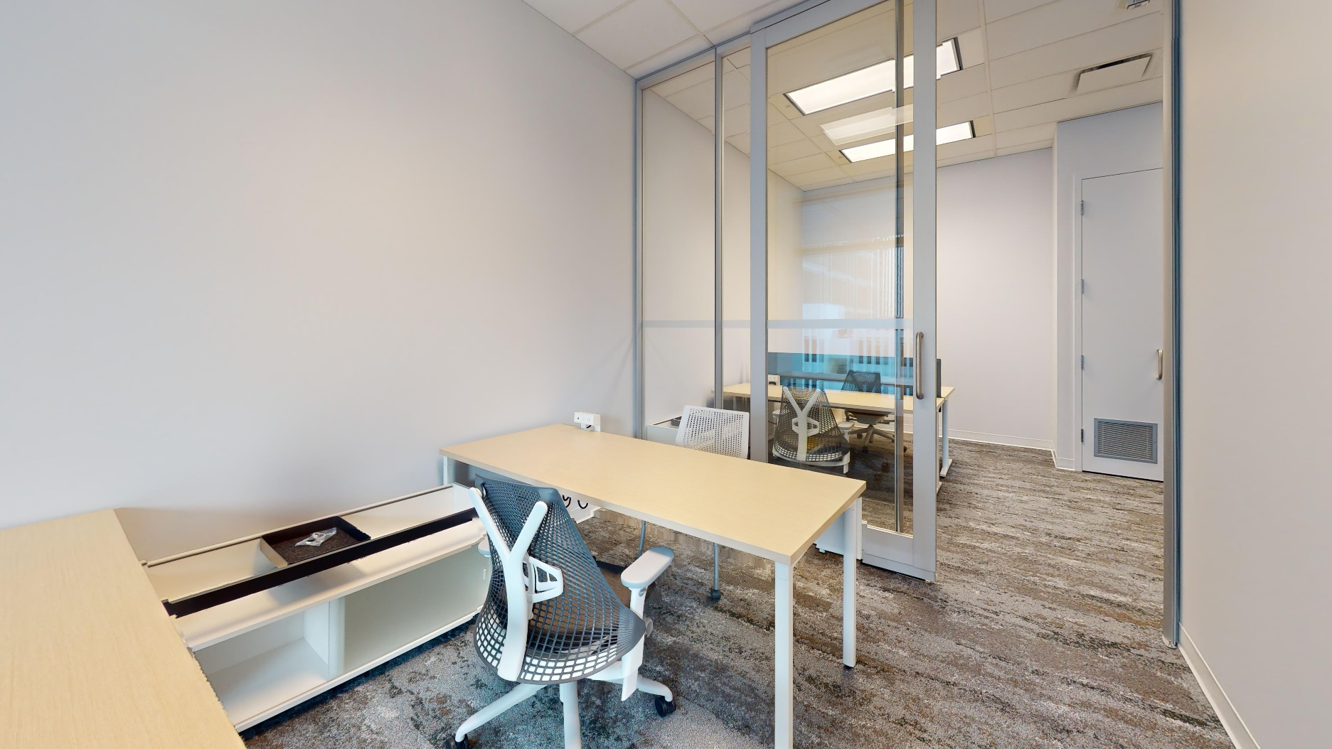
About Suite 303
2 offices open area | 742 SF
Grow your business in the center of it all. The common
space is equipped with TV, waiting area, and kitchenette with new appliances and complimentary Nespresso coffee. It’s filled with plush soft-seating and original art pieces. Wi-Fi ensures smooth sailing.
Bright natural light amplifies the space which comes fully furnished with Herman Miller furnishings.

Slide 3




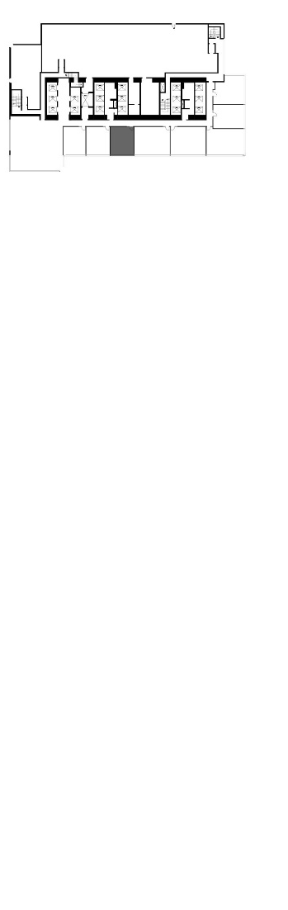
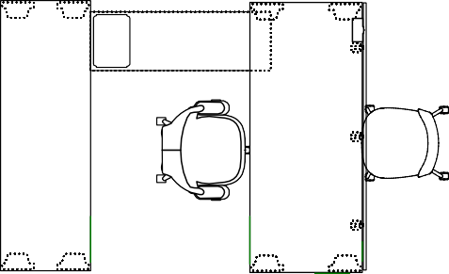
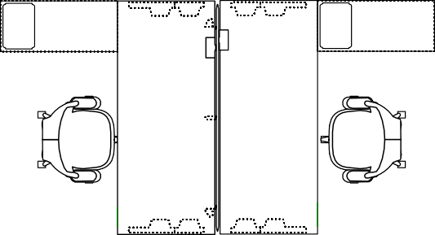

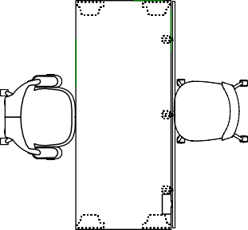
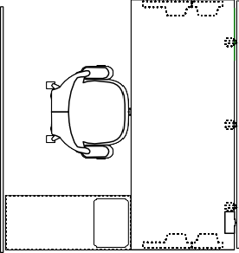

Suite 303
520 3rd Avenue SW
742 SF
Multi-use shared meeting rooms
2 offices and 3 workstations
Wi-Fi provided and fully furnished
Large windows overlooking Calgary
CF
CF
Rendering – 2-person workstation
Rendering – 2-person workstation
CF
Rendering – Private office

Slide 4
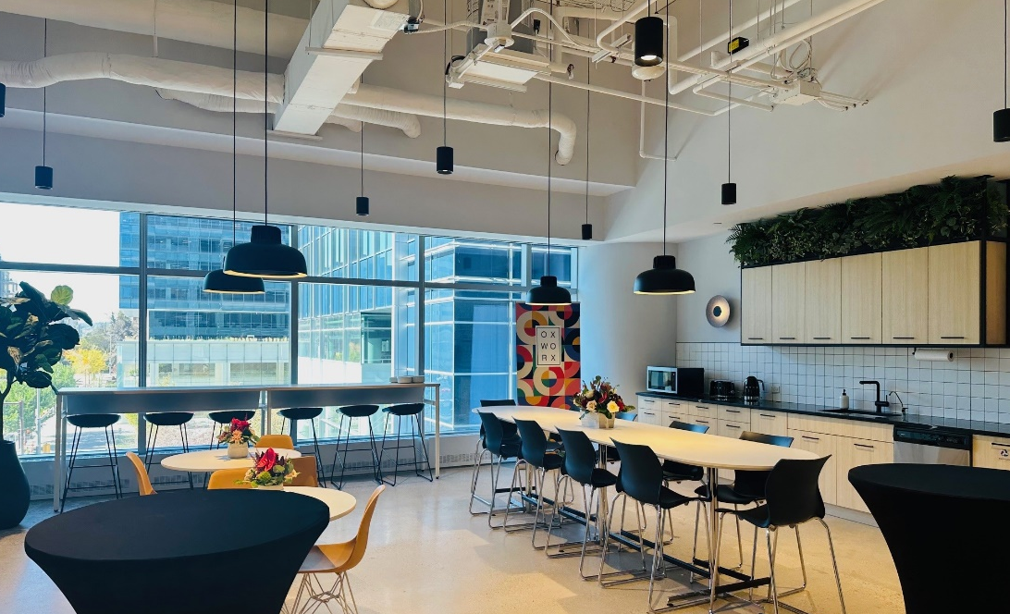
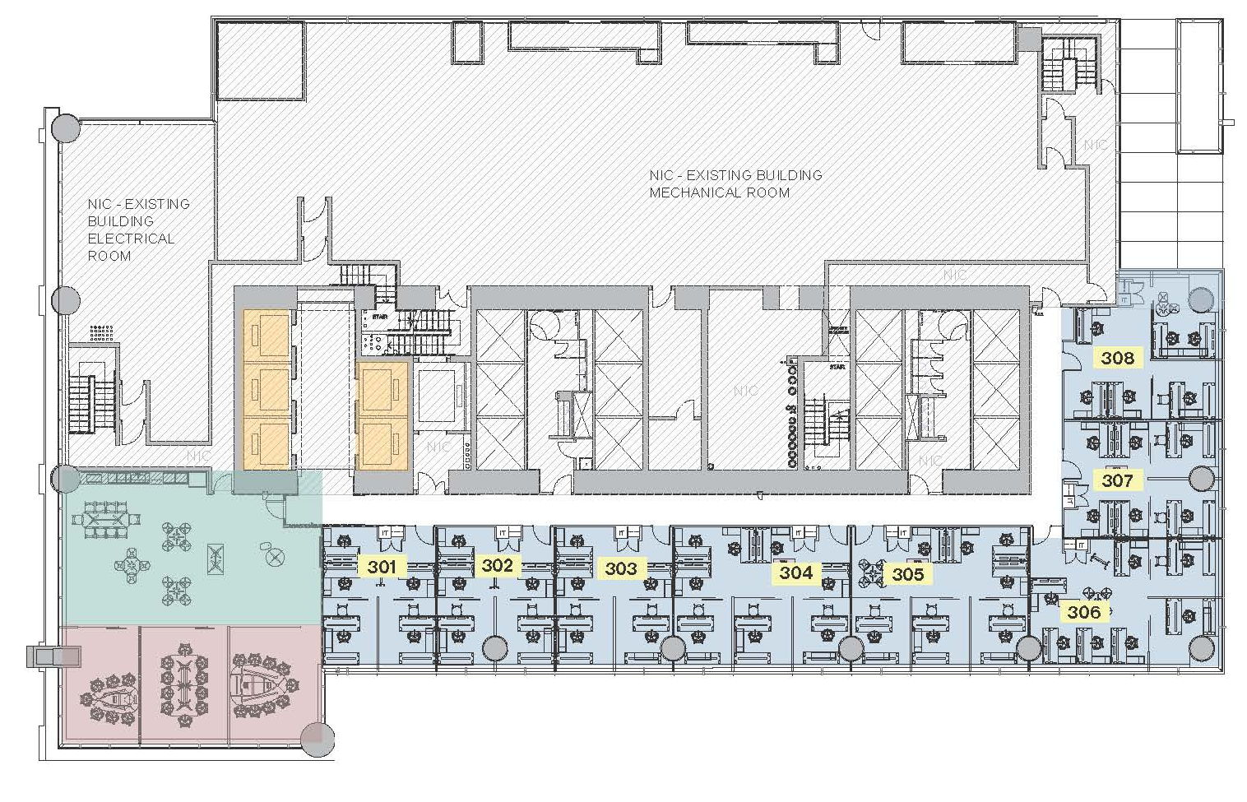
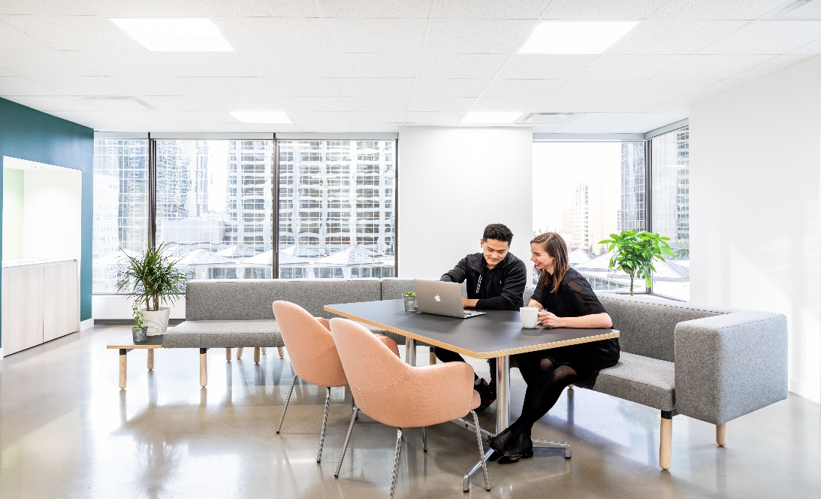
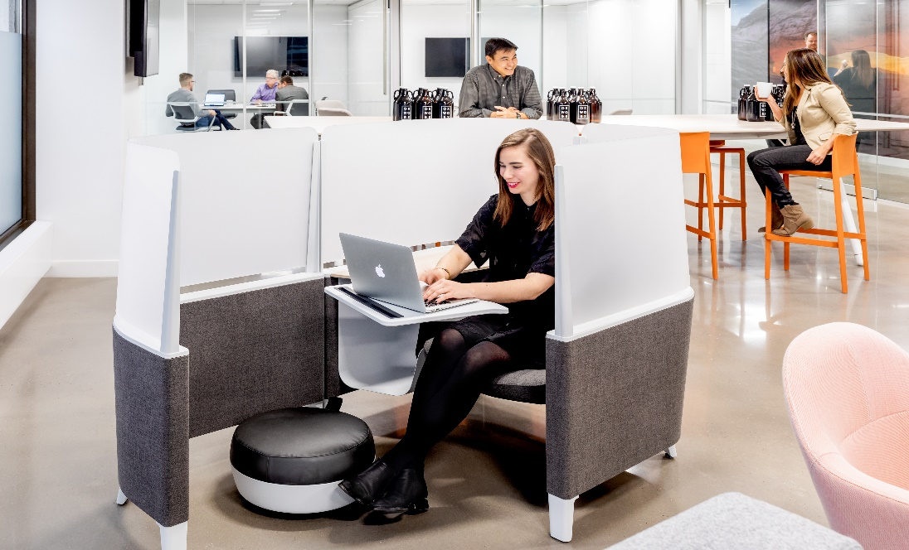
3rd Floor
Multi-use shared meeting rooms
Original artworks
Fully-wired and furnished
Large windows overlooking Calgary
Centennial Place East Tower
Shared Meeting Room
Elevators
Kitchenette & Lounge
Office

Slide 5
Connect
Sara Tokhanbeigi
Manager, Office Leasing
Mobile: 778.838.6201
Email: stokhanbeigi@oxfordproperties.com

