Slide 2
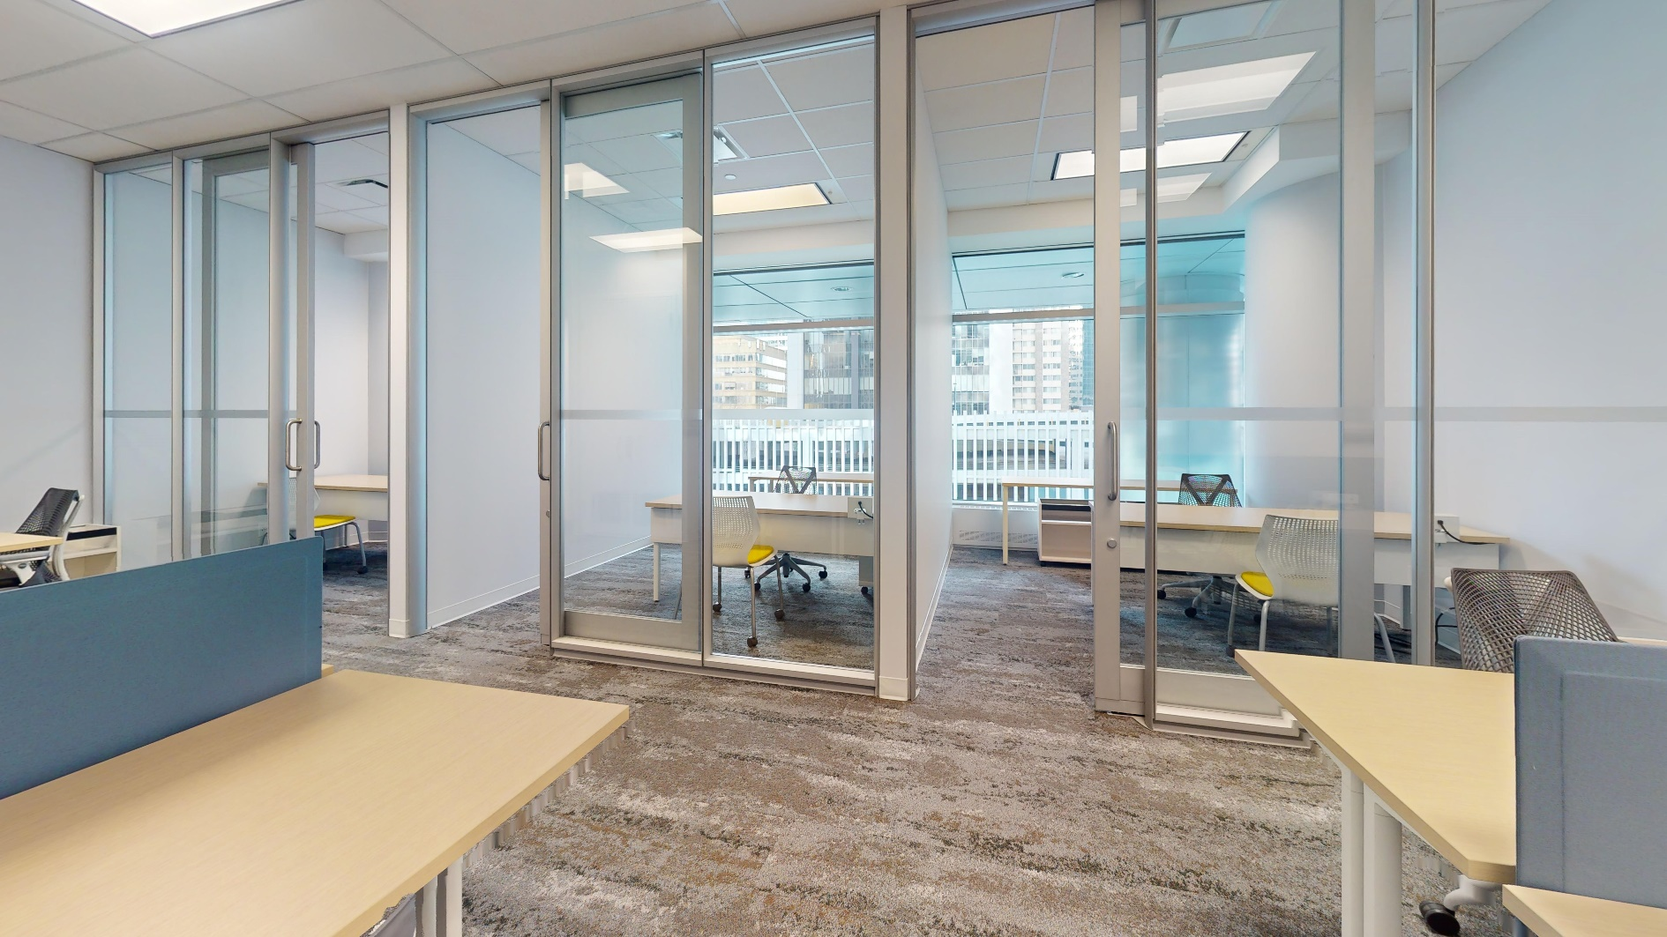
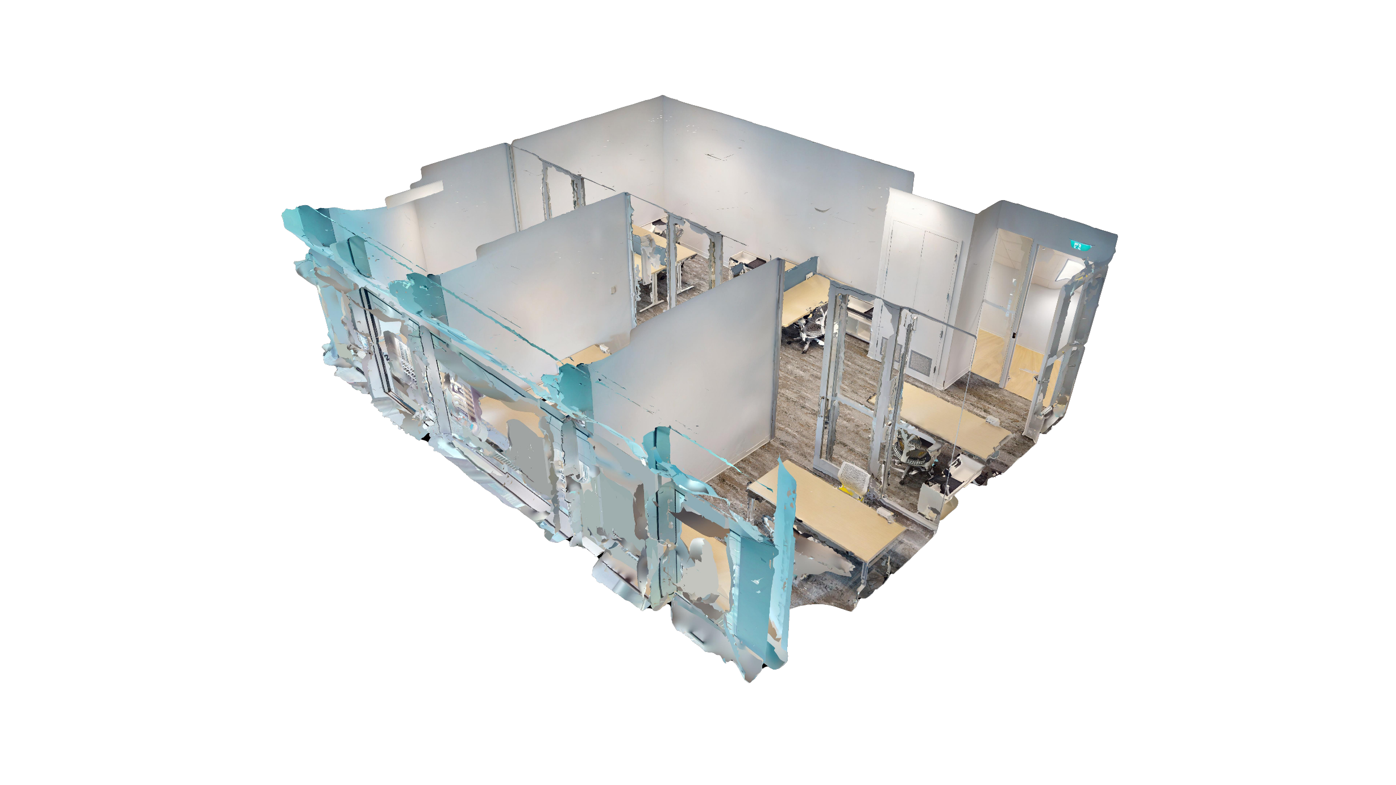
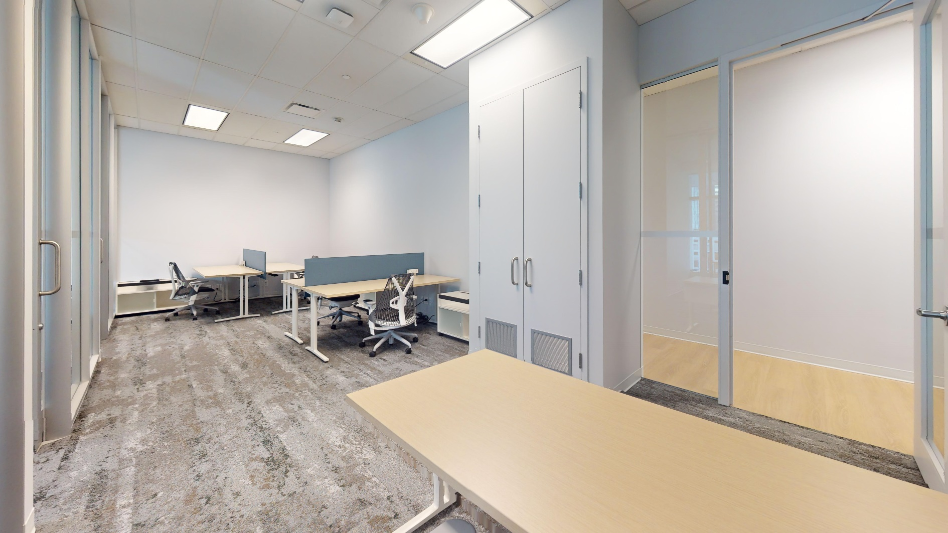
About Suite 304
3 offices open area | 1,112 SF
Grow your business in the center of it all. The common
space is equipped with TV, waiting area, and kitchenette with new appliances and complimentary Nespresso coffee. It’s filled with plush soft-seating and original art pieces. Wi-Fi ensures smooth sailing.
Bright natural light amplifies the space which comes fully furnished with Herman Miller furnishings.

Slide 3




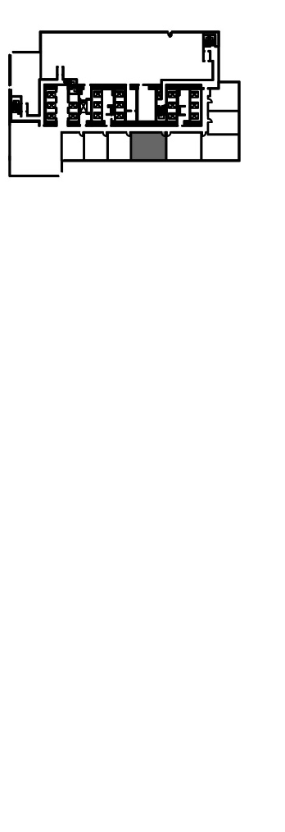
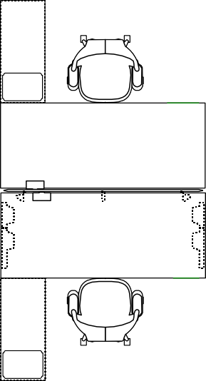
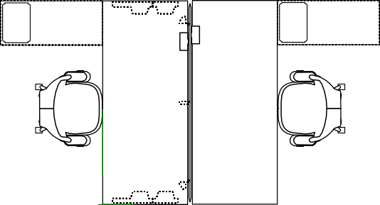

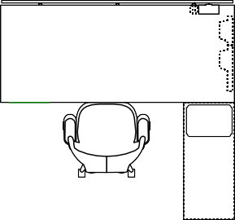




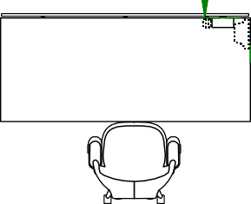
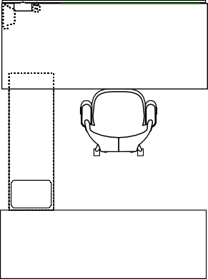
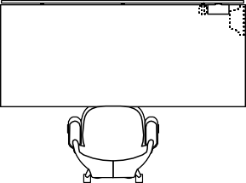



Suite 304
520 3rd Avenue SW
1,112 SF
Multi-use shared meeting rooms
3 offices and 5 workstations
Wi-Fi provided and fully furnished
Large windows overlooking Calgary
:·.·····:r. ::::::
D
CF
CF
-
./ ·...:..:......
,•, (::
:.:··
Rendering – 2-person workstation
:···:
:.,··
:.,··
:.,··
Rendering – 2-person workstation
Rendering – Private office

Slide 4
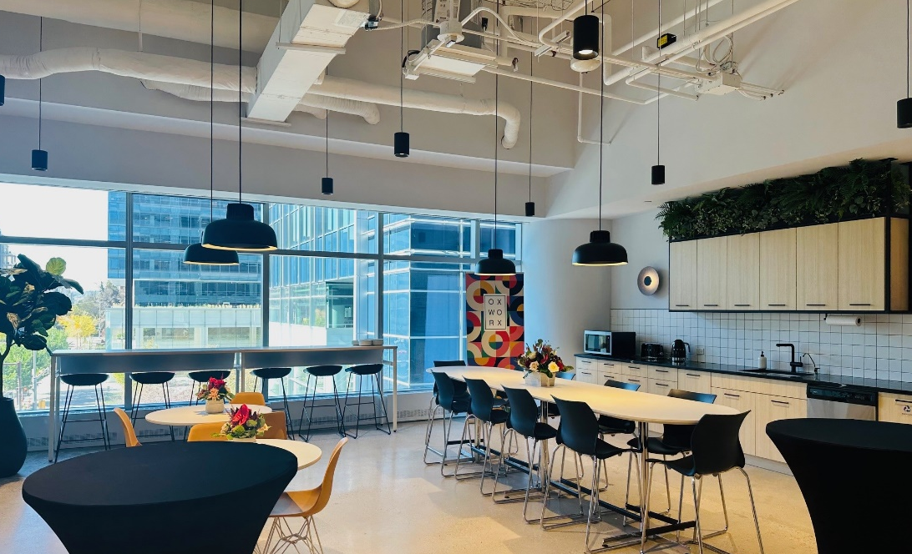
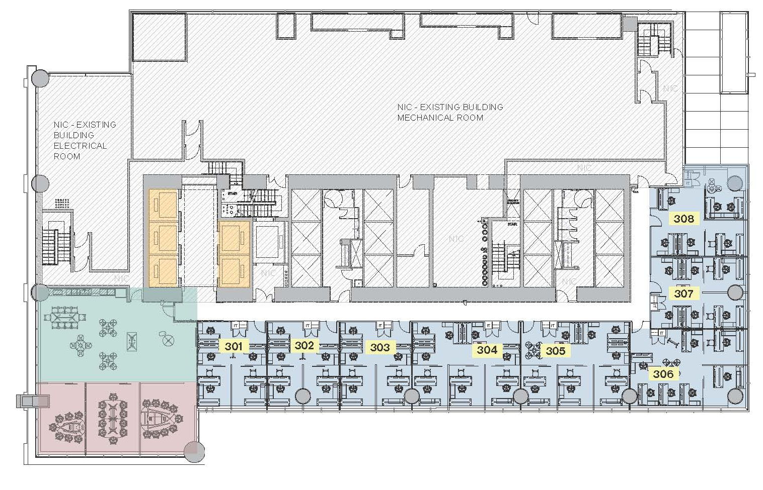
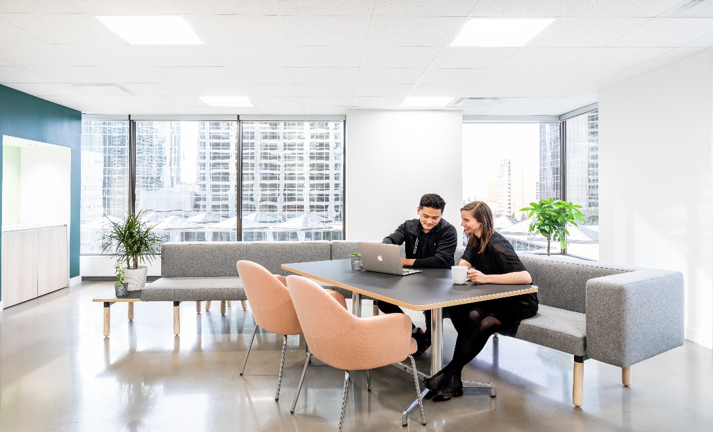
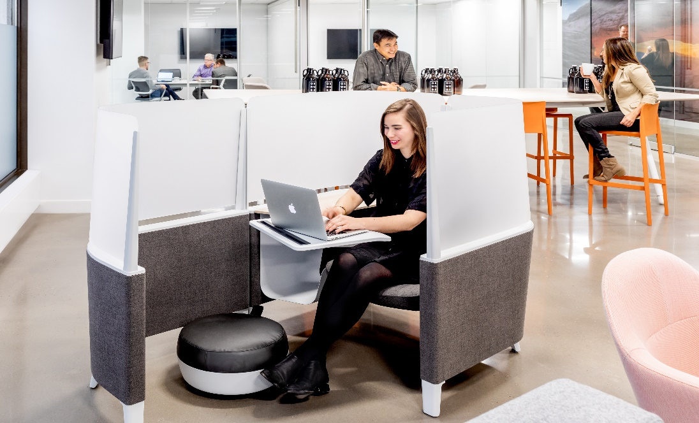
3rd Floor
Multi-use shared meeting rooms
Original artworks
Fully-wired and furnished
Large windows overlooking Calgary
Centennial Place East Tower
Shared Meeting Room
Elevators
Kitchenette & Lounge
Office

Slide 5
Connect
Sara Tokhanbeigi
Manager, Office Leasing
Mobile: 778.838.6201
Email: stokhanbeigi@oxfordproperties.com

