Slide 2
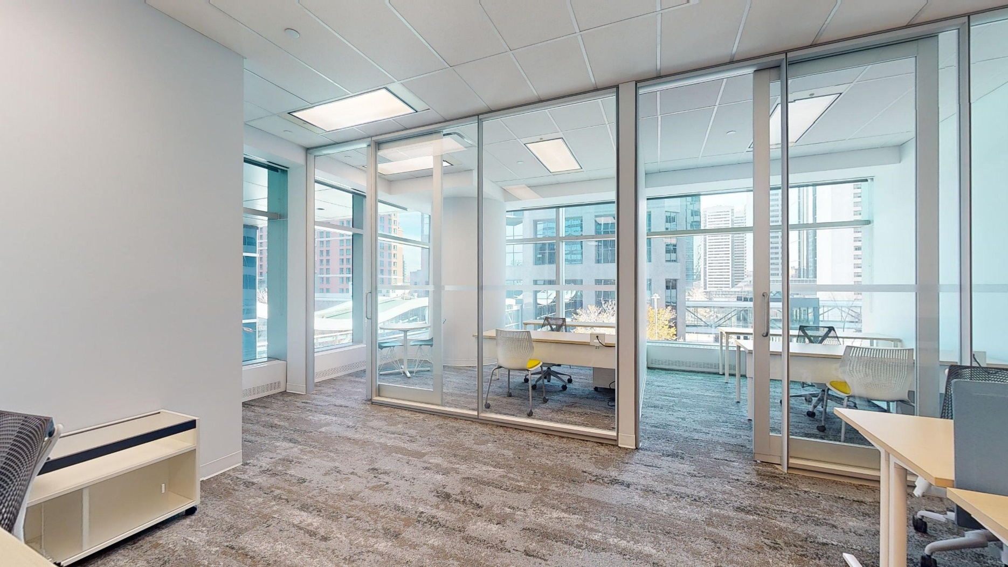
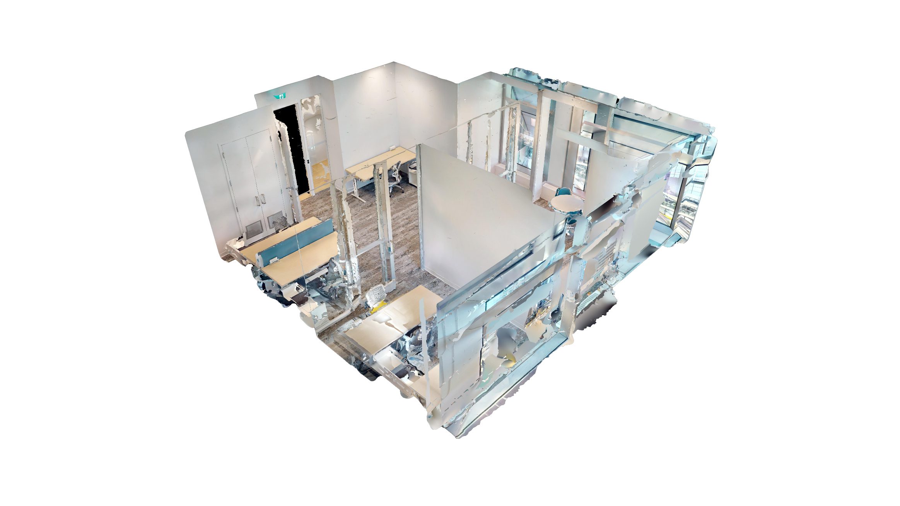
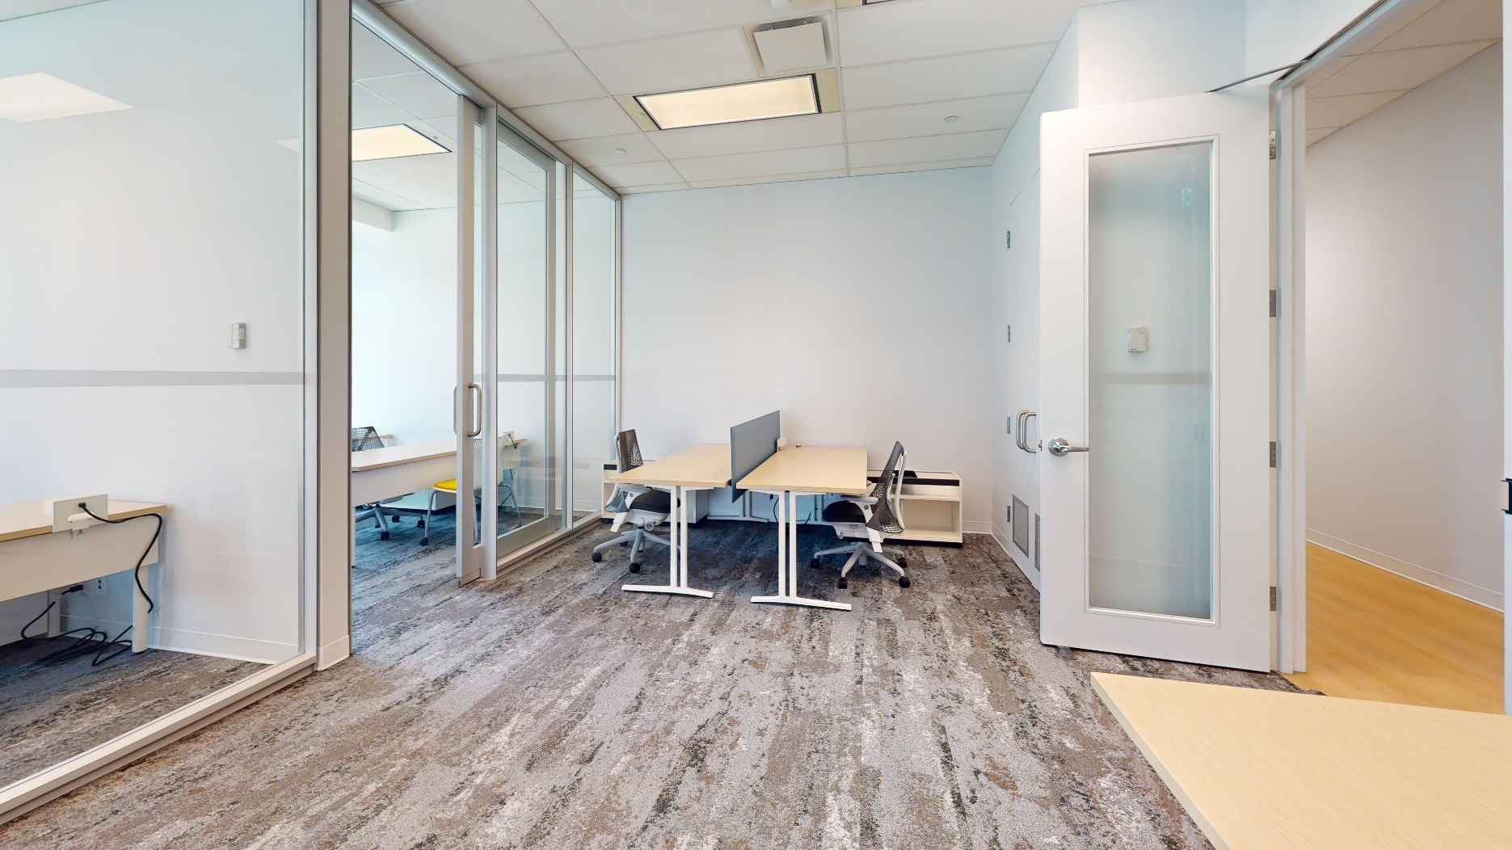
About Suite 308
2 offices open area | 917 SF
Grow your business in the center of it all. The common
space is equipped with TV, waiting area, and kitchenette with new appliances and complimentary Nespresso coffee. It’s filled with plush soft-seating and original art pieces. Wi-Fi ensures smooth sailing.
Bright natural light amplifies the space which comes fully furnished with Herman Miller furnishings.

Slide 3




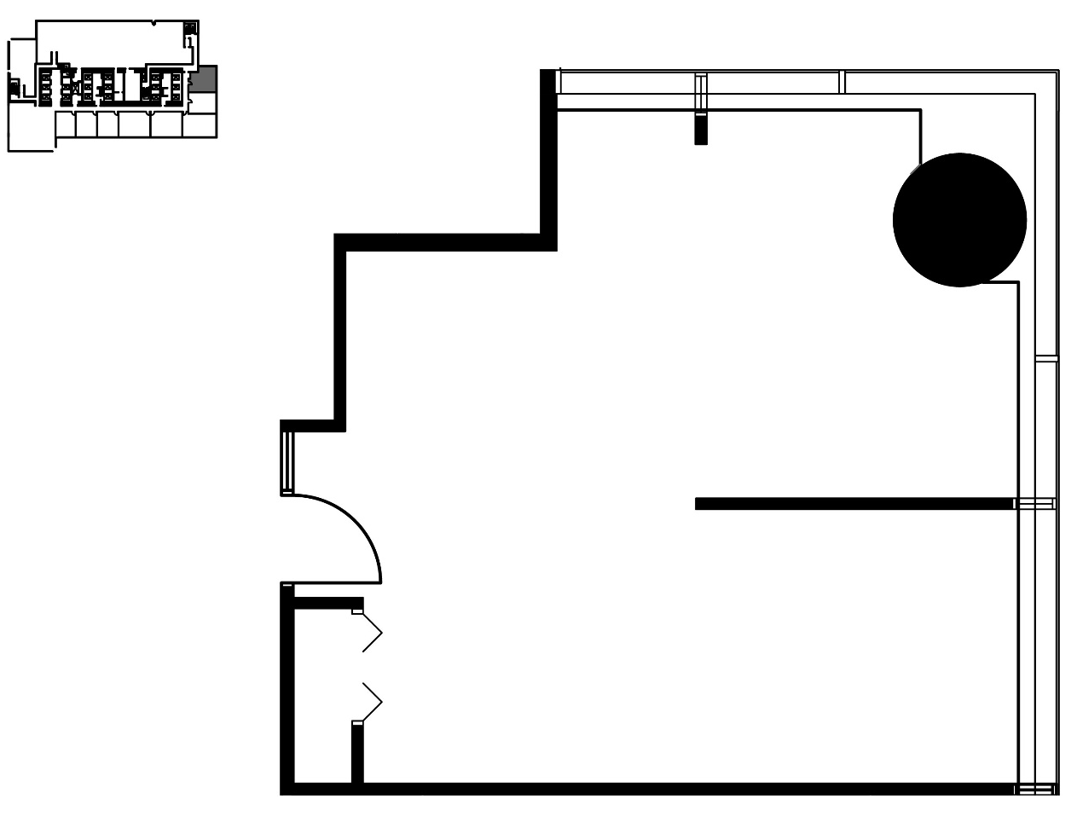

Suite 308
520 3rd Avenue SW
917 SF
Dynamic Spaces
for Those Who Lead
Grow your business in the center of it all. Common area includes TV, kitchenette, appliances, plush soft-seating and workstations!
Multi-use shared meeting rooms
2 offices and 4 workstations
Fully-wired and furnished
Large windows overlooking Calgary

Slide 4
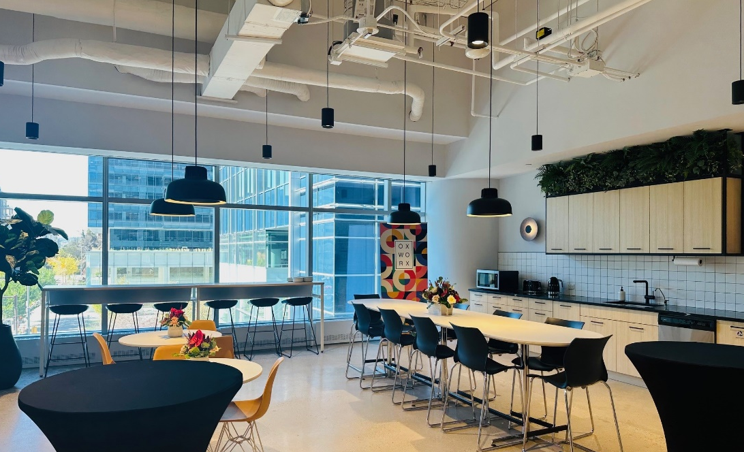
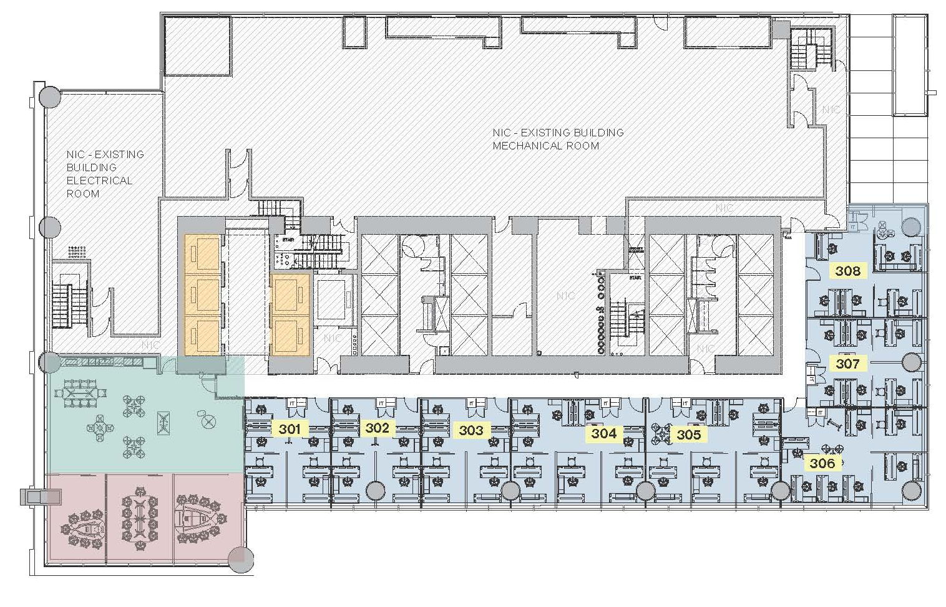
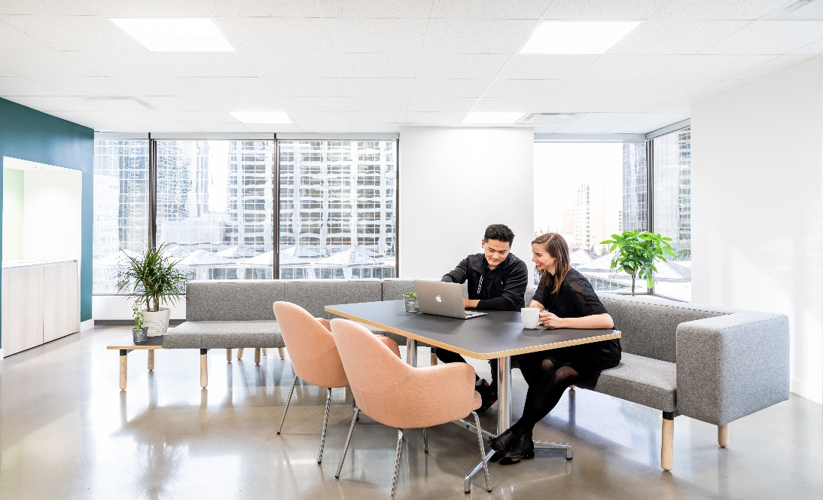
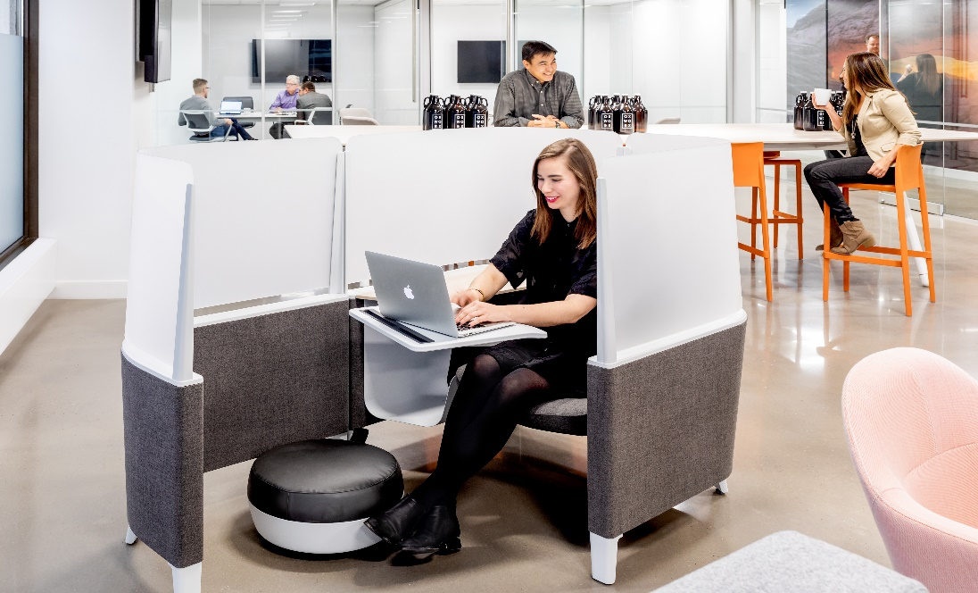
3rd Floor
Multi-use shared meeting rooms
Original artworks
Fully-wired and furnished
Large windows overlooking Calgary
Centennial Place East Tower
Shared Meeting Room
Elevators
Kitchenette & Lounge
Office

Slide 5
Connect
Sara Tokhanbeigi
Manager, Office Leasing
Mobile: 778.838.6201
Email: stokhanbeigi@oxfordproperties.com

